Slide 1
CORPORATE SPONSORSHIP
2023-2024

Slide 2
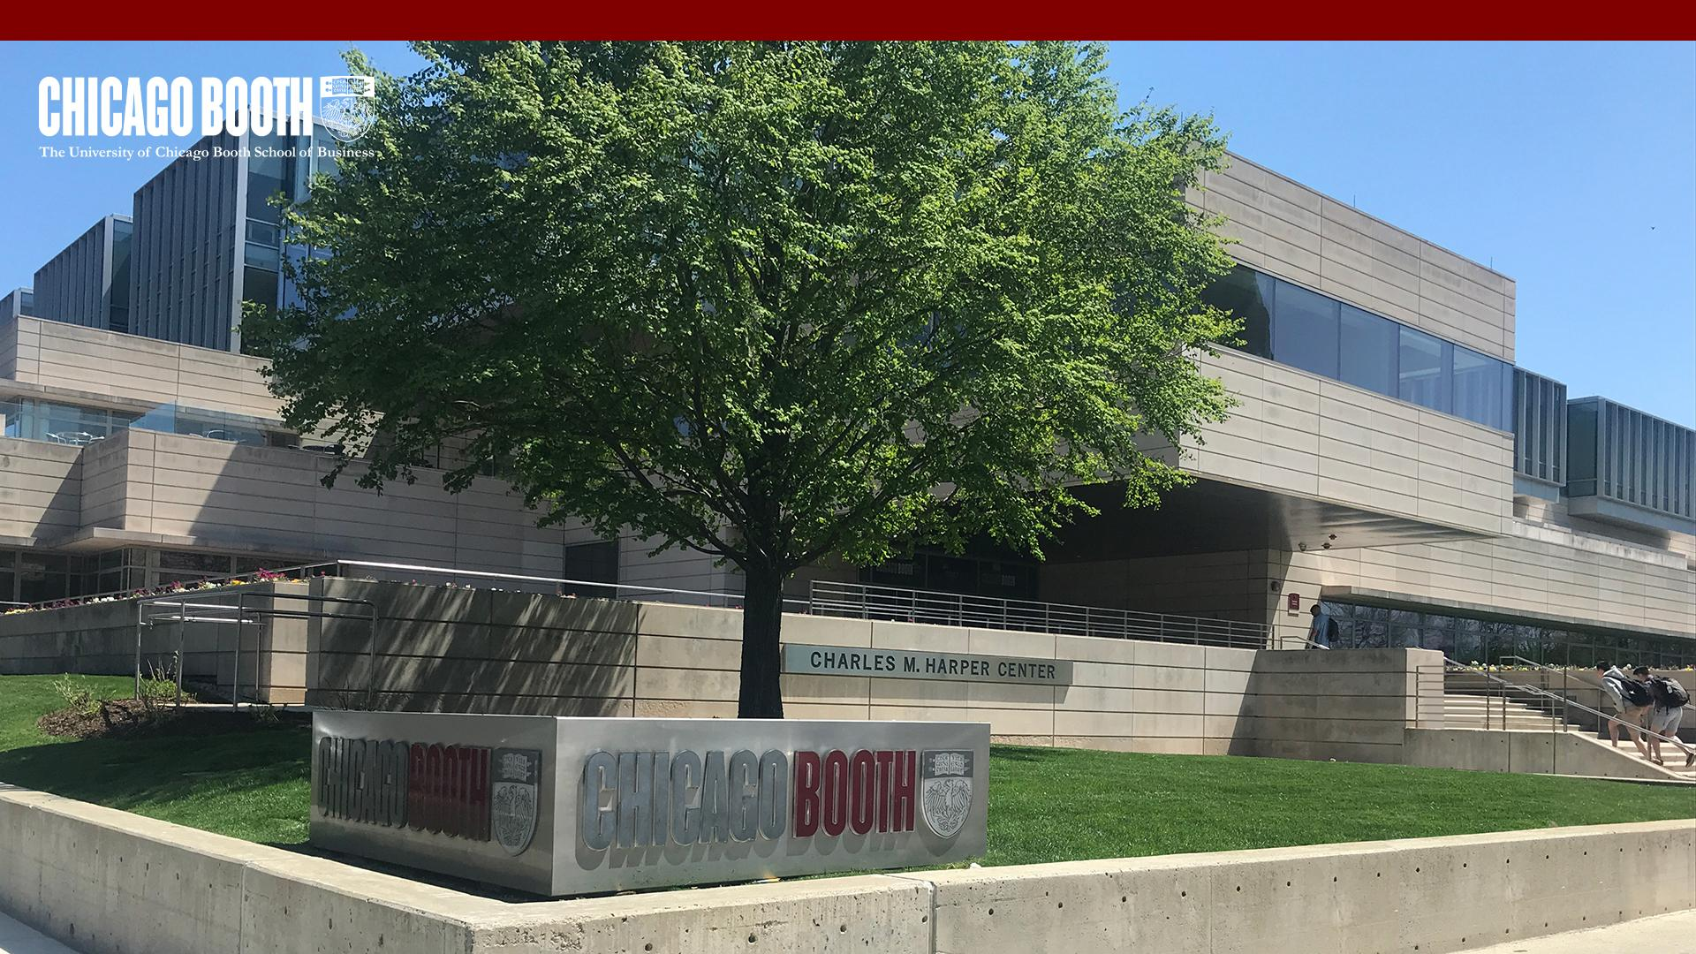
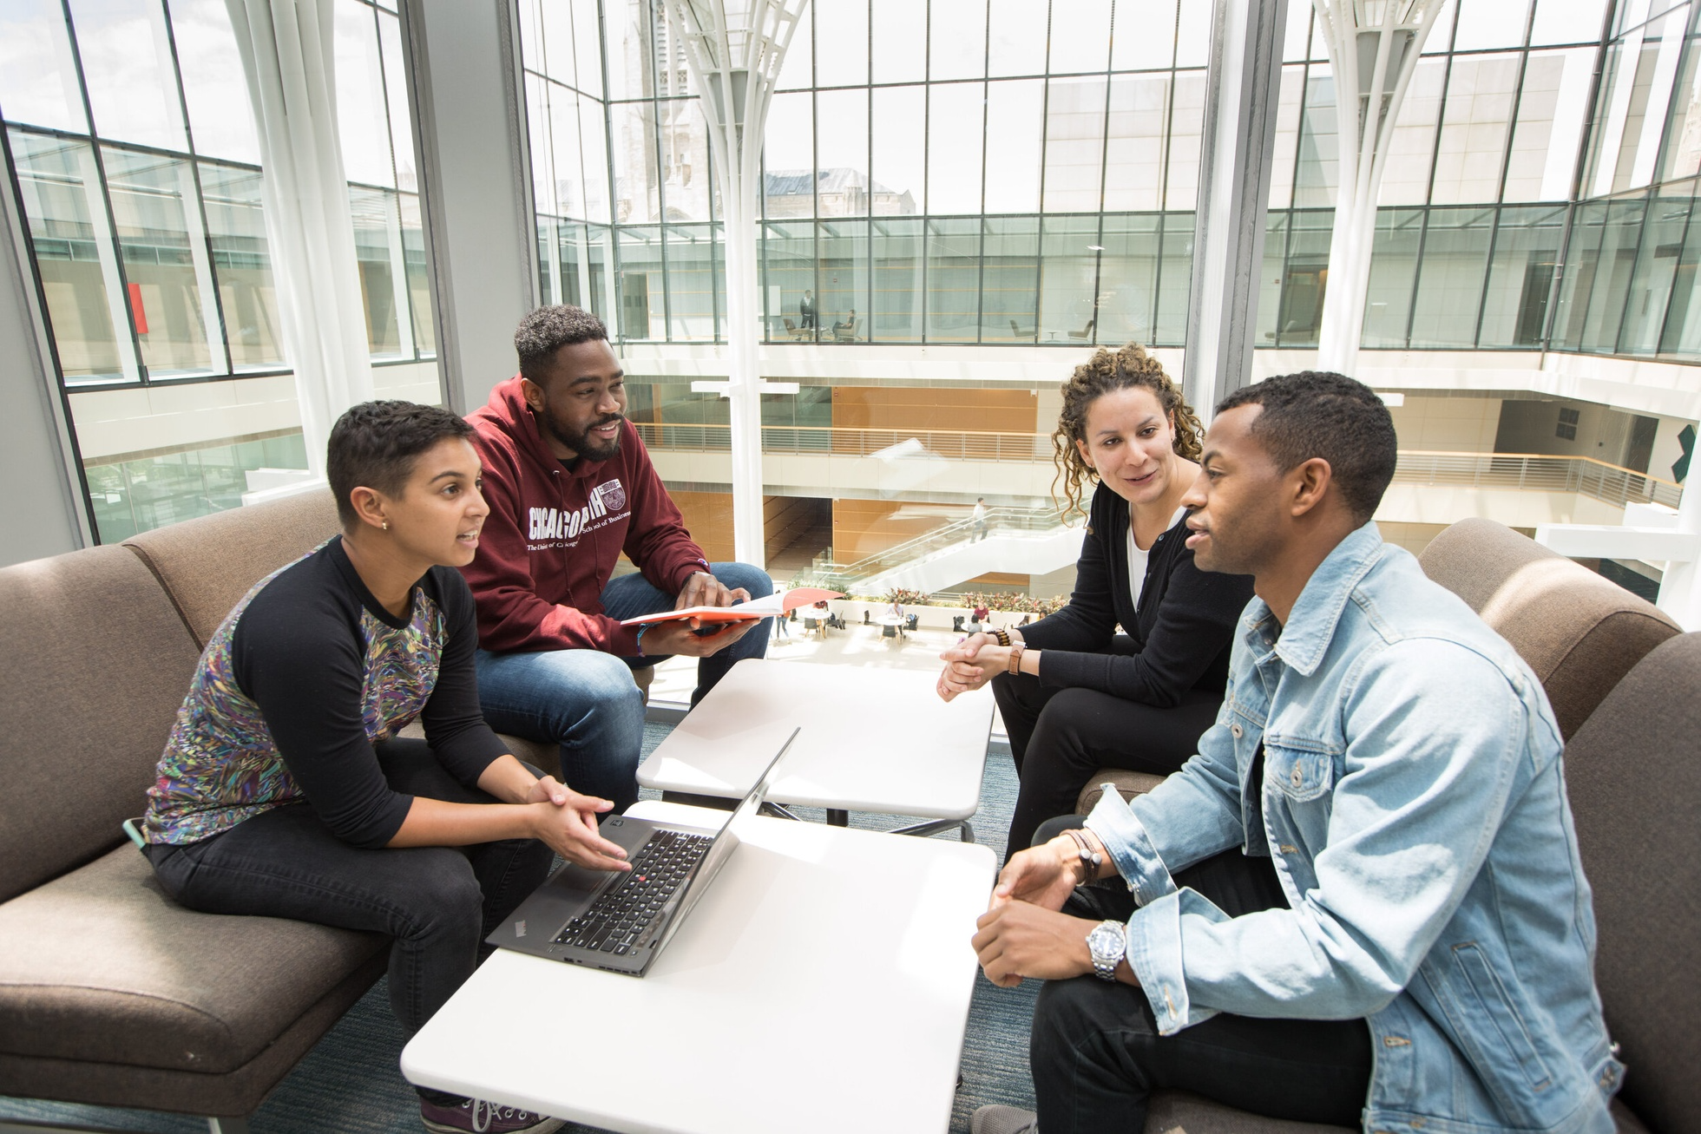
WHO WE ARE
The African American MBA Association (AAMBAA) provides a forum for interaction between students of African descent at Chicago Booth and the University community, corporate partners, and the City of Chicago.

Slide 3
WHAT WE DO
Admissions
Provide Black prospective students with application assistance and match admitted students with buddies that help them learn more about the Booth experience
Careers
Connect members with companies through diversity career events, assist them with interview preparation through recruiting families, and organize alumni mentorship pairings to ensure internship success
Internal Community
Curate a community that fosters belonging for all Black students at Booth through small group dinners, social outings, and more
External Community
Strengthen bonds within Chicago through community service, hosting an annual business conference (DuSable), and connecting regularly with AAMBAA alumni
Admissions | Careers | Internal Community | External Community

Slide 4
WHY SPONSOR US
TOP MBA PROGRAM
SKILL DEVELOPMENT
WORLD-CLASS TALENT
Currently Ranked #1 in U.S. News
AAMBAA collaborates with university centers and student clubs to encourage multidisciplinary skill development for professional success
AAMBAA connects world-class talent with corporate partners to advance the professional development for our members and DEI priorities for our partners
Booth has been consistently ranked as a top MBA program (#1 U.S. News and World Report in 2022-2023 & 2023-2024)
Sponsoring AAMBAA provides an opportunity to access top talent and support your firm’s DEI initiatives, all while being associated with a top MBA program.

Slide 5
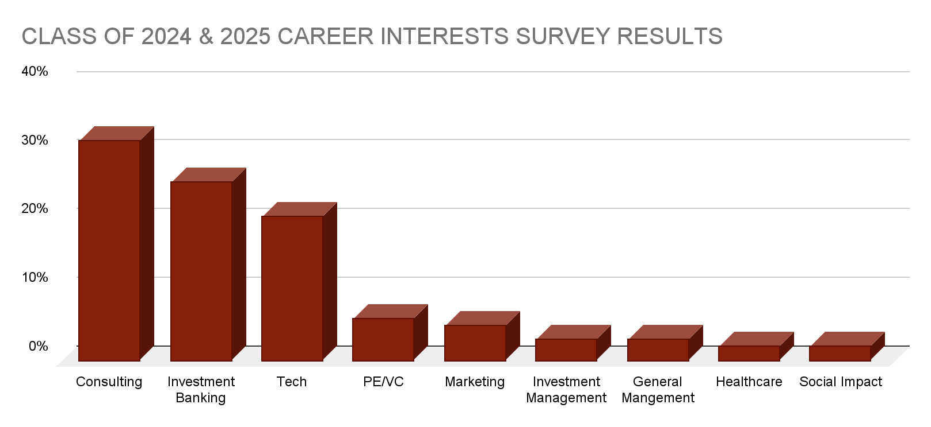
TENTATIVE CAREER INTERESTS
Based on career interest survey data from AAMBAA Class of 2024 and 2025, our members have a wide range of interests, with a concentration in Consulting, Investment Banking, and Tech.
Notes:
Percentage versus numbers - Career services
Show value prop to non big 3 - career services
good for consulting, banking, tech
remove for non big 3
Alumni and sponsors - can send a job postings to old alumni as a value thing for sponsors
reach out to cbaa on how to work with partners,

Slide 6
2023 / 2024 ACADEMIC YEAR EVENTS
QUARTER | EVENTS
Fall (September 2023 to December 2023) | Fall 1Y Welcome Retreat Diversity Career Night Sponsor Interactive Company Workshops* Sponsor Happy Hours and Small Dinners* Sponsor 1v1 Recruiting Coffee Chats*
Winter 2024 (January - March) | MLK Day Community Service Black History Month Celebration 39th Annual DuSable Conference
Spring 2024 (April - June) | Internship Preparation Workshops Professional Development Workshops Spring 2Y Sendoff Retreat
*Highlighted activities may occur throughout the school year

Slide 7
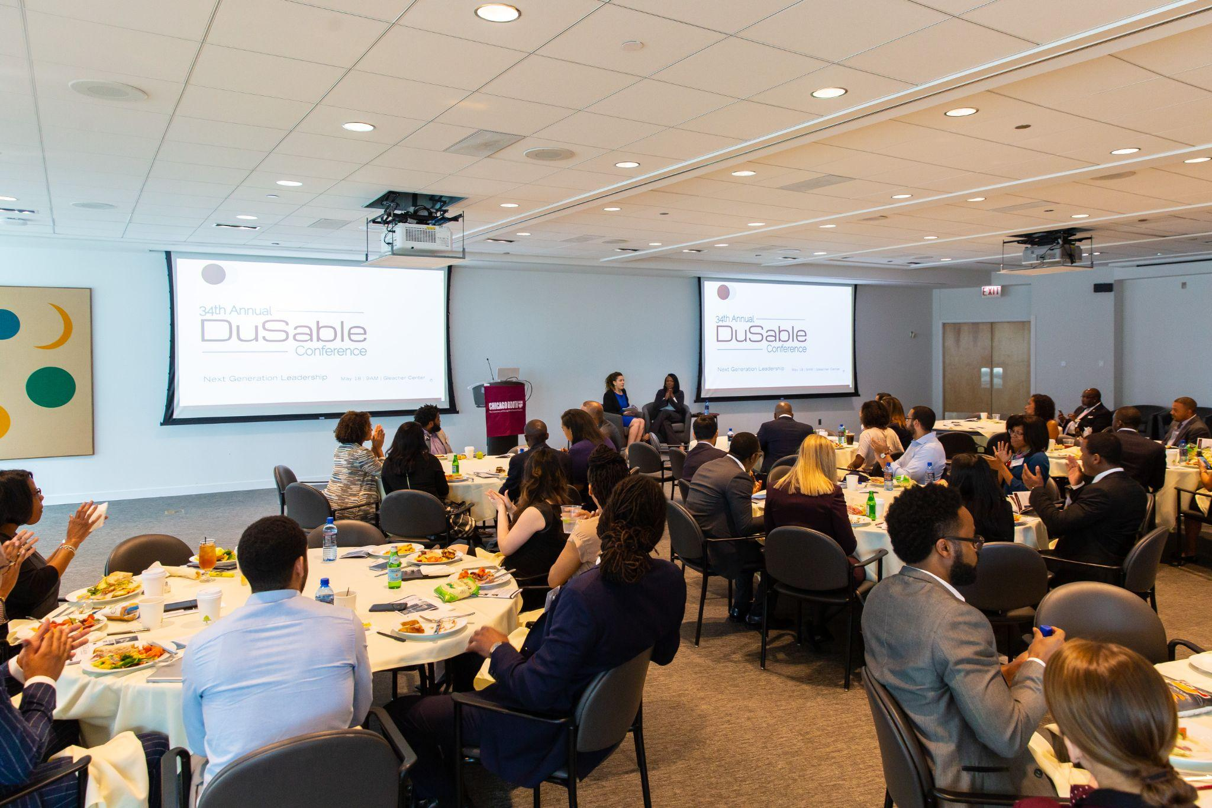
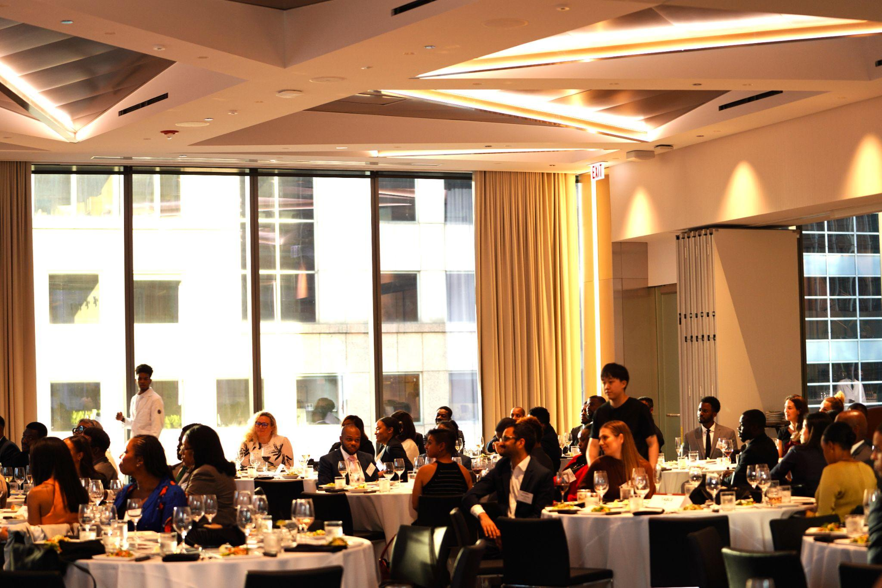
39TH ANNUAL DUSABLE CONFERENCE
The DuSable Conference is hosted annually by AAMBAA and aims to serve as the nexus for activity in Chicago's Black business economy by delivering content to encourage collaboration between AAMBAA students and alumni, Chicago Black business owners, Chicago Black professionals, and the broader University of Chicago Black constituency.
Speakers for the 38th Annual DuSable Conference (2022/2023) included:
Louis Carr, President of Media Sales, BET Networks
Diane D. Carr, Founder & CEO, DDC Consulting Group
Naomi Davis, Founder & CEO at BIG! Blacks in Green
Ernst Valery, Managing Member, SAA | EVI Development
Katrina A. Roddy, Official Member of Forbes Coaches Council
Event Timing: Saturday, February 10, 2024

Slide 8
2023 DIVERSITY CAREER NIGHT
TOP TALENT
THE RIGHT TIME
NETWORKING
Chicago Booth School of Business has assembled the right talent for you to expand your talent pipeline and progress on DEI initiatives
Diversity Career Night will take place in the Fall quarter to enable your team to build relationships with members early in the academic year
Diversity Career Night takes place in person on Chicago Booth’s campus so you can connect with students to find the best talent for open roles and foster relationships for future opportunities
Event Timing: Late October, 2023

Slide 9
2023 / 2024 SPONSORSHIP PACKAGES
 | Platinum | Gold | Silver | Bronze | Friends of AAMBAA
 | 1 | 5 | 8 | 10 | 15
 | $ 8,000.00 | $ 6,000.00 | $ 4,000.00 | $2,000.00 | $ 1,000.00
DUSABLE CONFERENCE BENEFITS
Guaranteed DuSable conference panel or speaker | X
Specialized social media coverage prior to and during conference | X
Opportunity to participate within a conference panel | X | X
Tickets to 39th Annual DuSable Conference | 4 | 2 | 1
Sponsorship level highlighted in DuSable Booklet | Full Page | Half Page | Name
YEAR LONG BENEFITS
Priority guest speaker for industry events throughout academic year | X
Opportunity to host interactive company workshop (e.g. Lunch and Learn, “Day In The Life”, Case Study, etc. ) | X | X
Opportunity to host one AAMBAA happy hour or small group dinner | X | X
Opportunity to host 1v1 student informational coffee chats | X | X | X
AAMBAA Resume Book | X | X | X | X
Sponsorship level highlighted in bi-weekly newsletters | X | X | X | X
Sponsorship Recognition on AAMBAA website, and social media accounts | X | X | X | X
Job Postings within AAMBAA Current Student Network | X | X | X | X | X
DIVERSITY CAREER NIGHT BENEFITS
Access to Diversity Career Night | X | X | X | X | X
For more information and inquiries about the sponsorship packages mentioned, please contact this year’s sponsorship leads.

Slide 10
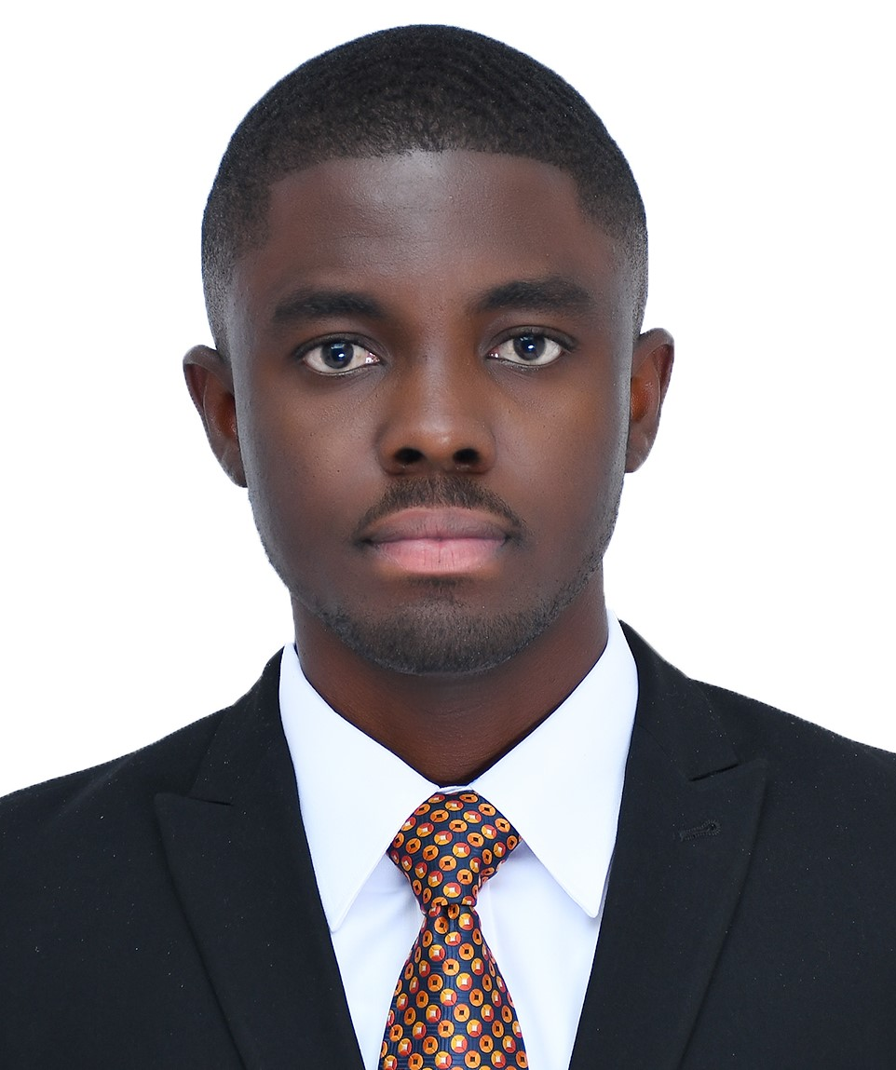
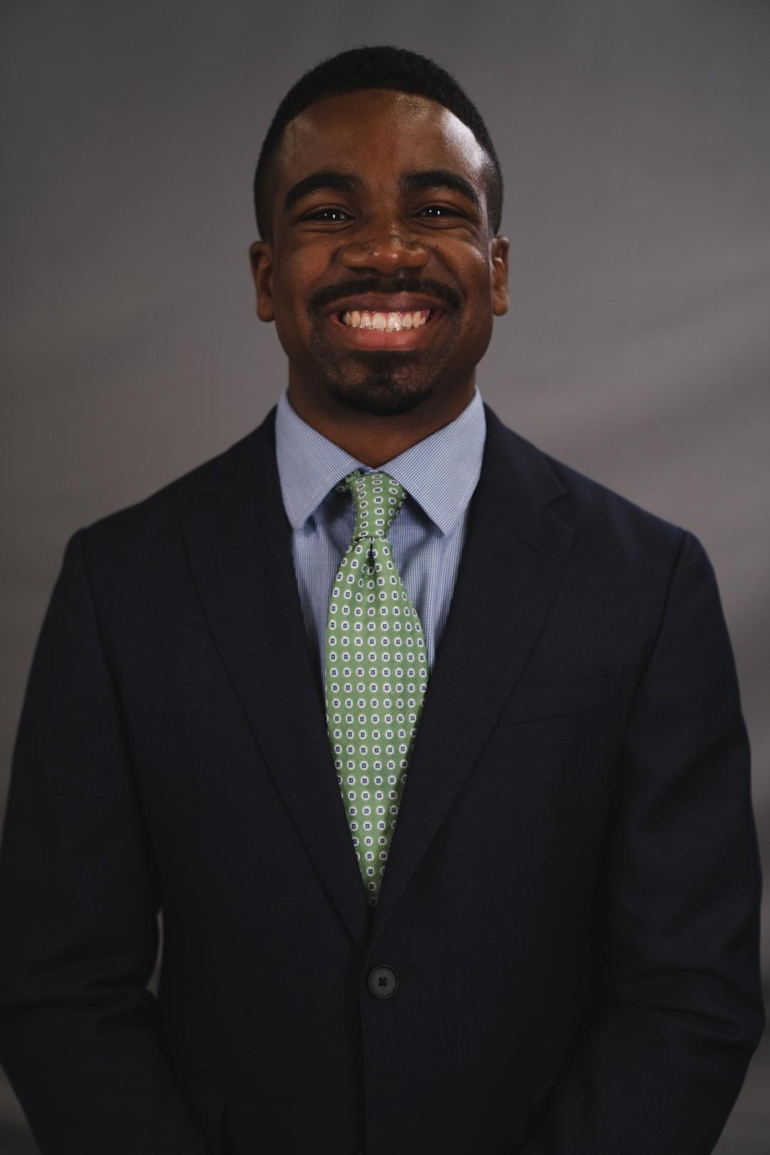
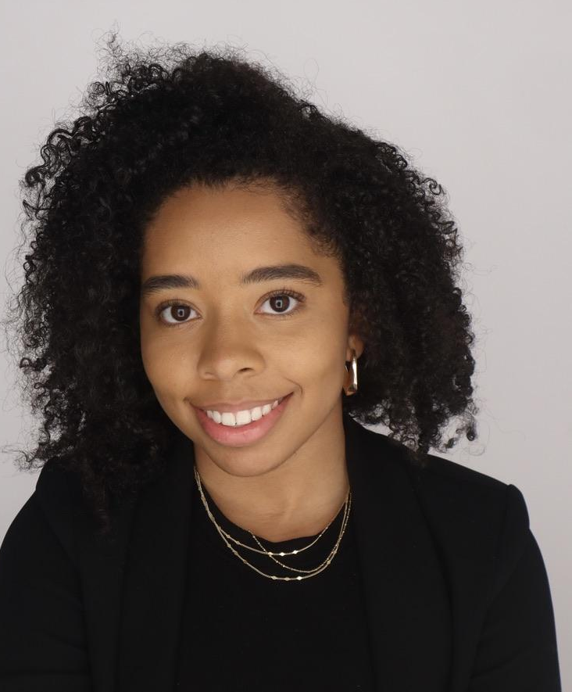
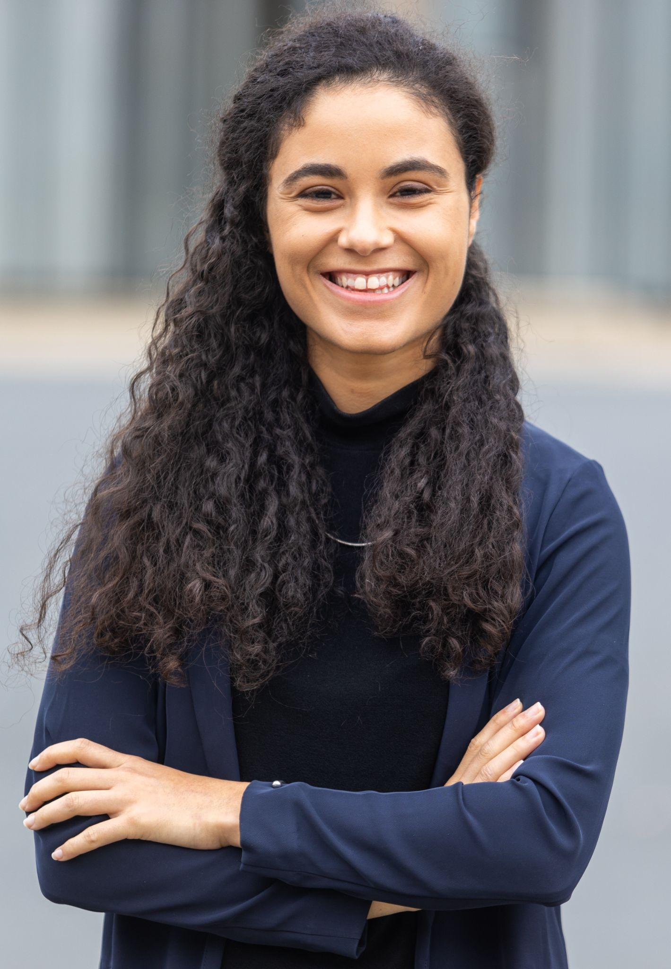
Contact Us!
2023-2024 Sponsorships Leads
Prince Akonor Asare
Blaise Fairfax
Kennedy Sapp
Jordan Lewis
Camille N’Diaye-Muller
Sponsorships
pasare@chicagobooth.edu
Admissions, Sponsorships
bfairfax@chicagobooth.edu
Branding
ksapp@chicagobooth.edu
Community Relations & Alumni
jlewis50@chicagobooth.edu
Operations and DuSable Lead
cmndiaye@chicagobooth.edu
For more information about partnering with us, please contact Prince and Blaise.
We are excited to hear from you and appreciate your interest in supporting AAMBAA. Thank You!

